Slide 1
Predicting Employee Attrition and Monthly Income: A Case Study
Matthew David
Date: 4/13/2023

Slide 2
Objectives
The Leading Factors to Attrition
Top Three factors
Oversampling for Attrition
Developing a KNN model for predicting Attrition
Discuss Key Statistics of KNN model
Predicting Monthly Income
Generating the most predictive model
Comparing these models
Final Model Selection
Checking the assumptions of the model
Additional objectives:
Discuss the relationship between Job Role and Monthly Income
Highlight R Shiny App

Slide 3
Preparing the data
Zero missing values in either dataset
Convert character variables to factor variables
Remove the Over18 column
Only one factor “Yes”

Slide 4
The Leading Factors of Attrition

Slide 5
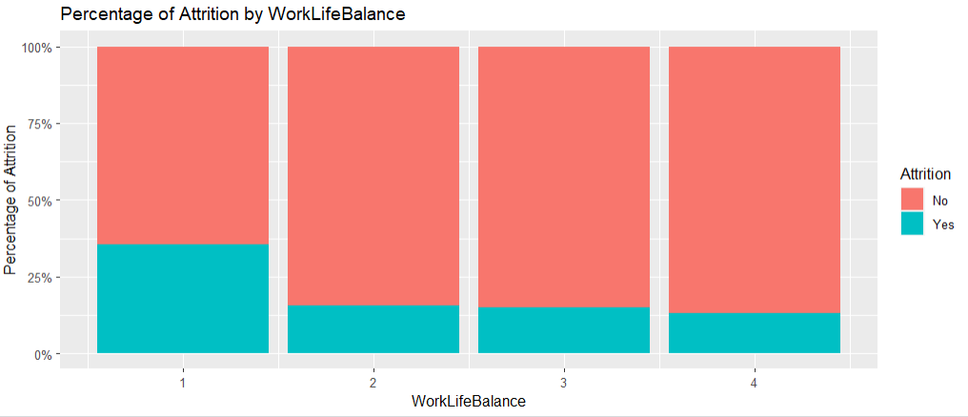
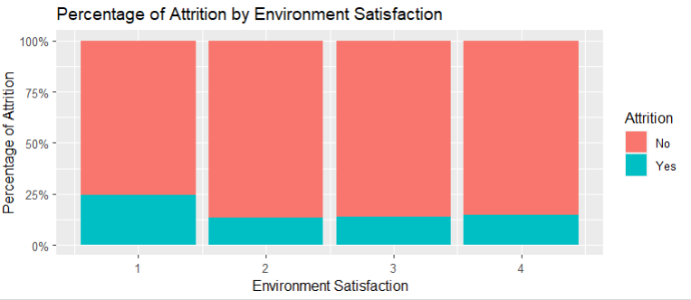
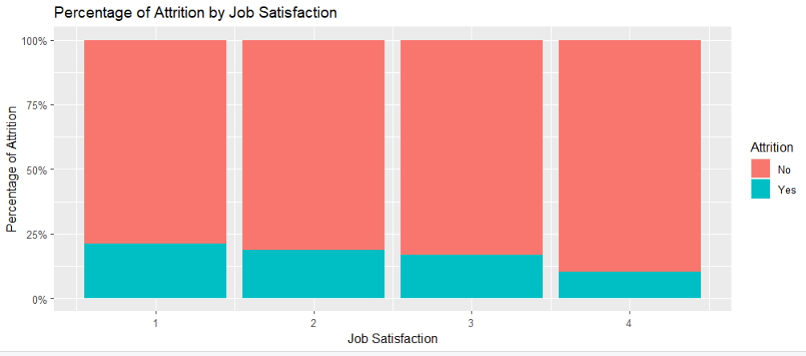
Top Three factors
Job Satisfaction
Environment Satisfaction
WorkLifeBalance
Additional factors
Performance rating
YearsAtCompany

Slide 6


Oversampling for attrition
Wanted to use KNN model to predict Attrition
response “No” greatly outnumbered response “Yes”
Using Oversampling we balanced the attrition column

Slide 7
Our Knn Model
Split the balanced data into 75% training and 25% testing datasets.
Used the KNN (K-Nearest Neighbors) model for classification
Variables: JobSatisfaction,YearsAtCompany,EnvironmentSatisfaction, PerformanceRating, & WorkLifeBalance
Achieved an accuracy of 84% on the test set
Achieved a sensitivity of 70% on the test set.
Achieved a specificity of 96% on the test set.

Slide 8
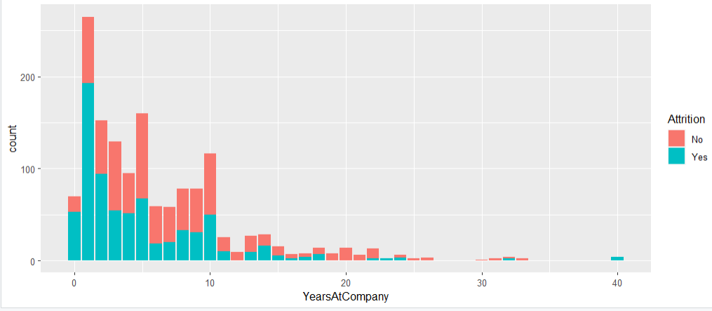
Interpretations
Accuracy of 84% indicates the model is performing well and has a relatively high level of accuracy
As years at company increase attrition rate decreases
As work life balance, job satisfaction, performance rating, and environment satisfaction increases, attrition decreases

Slide 9
Predicting Monthly Income

Slide 10
Generate the most predictive model
We produced 3 automatic selection models
Forward
Backward
Stepwise
Each model indicated Job Role, and Job Level were key variables at predicting Monthly income
Backward model had the lowest CVPress and was the best at generalizing onto new sets of data
Custom Model removed Variables with NA’s from backward model(Standard Hours, Employee Count)
Model | Adjusted R^2 | CVPress
Forward | 0.95 | 1063.1
Backward | 0.95 | 1061.7
Stepwise | 0.95 | 1063.1
Custom | 0.95 | 1061.7

Slide 11
Monthly Income ~ Job Role + Job Level + Total Working Years + Years with Current Manager + Years Since Last Promotion+ Business Travel
Final Prediction Model

Slide 12
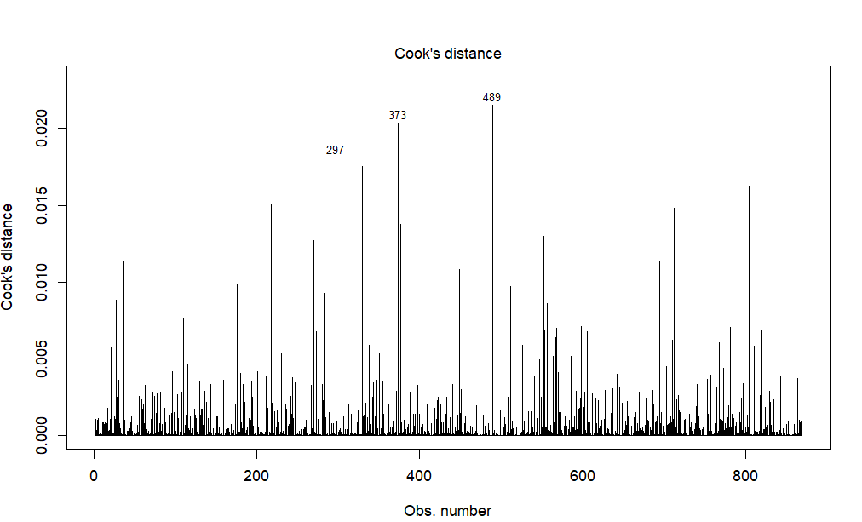
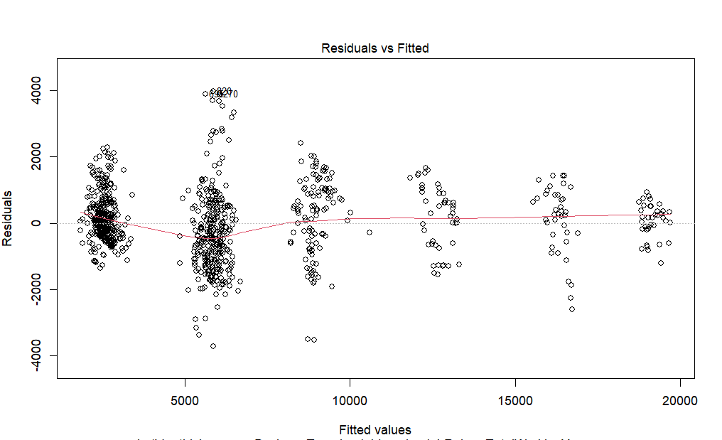
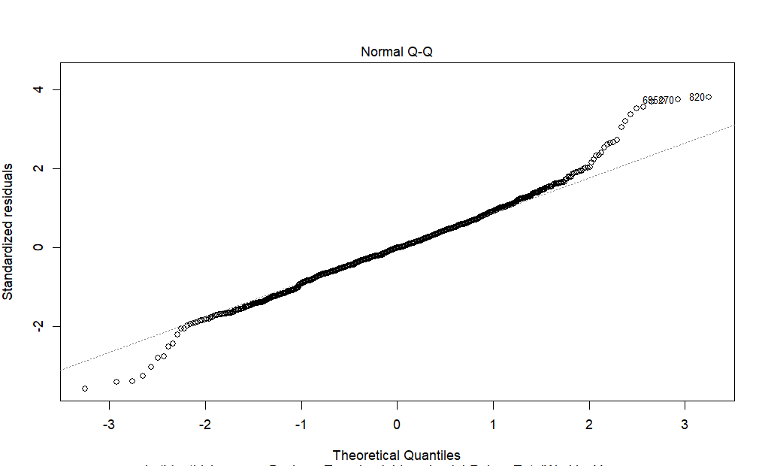
Checking the assumptions of the model
Normality
Looking at the Q-Q plot there does seem to be some evidence of outliers however upon checking the Cook’s distance they appear to not be influential.
Equal Variance
Looking at the plot of residuals versus fitted points there is not enough visual evidence to suggest against equal variance of the residuals.
Independance
Utilizing the original dataset we proceed under the assumption of independence in and between variables.

Slide 13
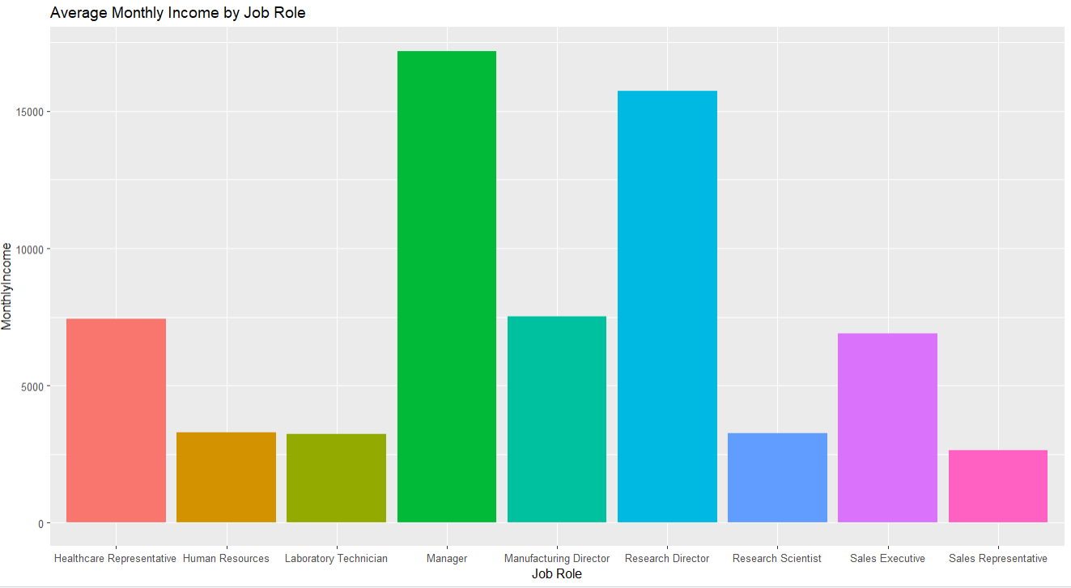
Relationship between Monthly Income & Job Role
Manager was the Highest paid Job Role
Manager Attrition rate of 7.8%
Average Attrition rate of 16%

Slide 14
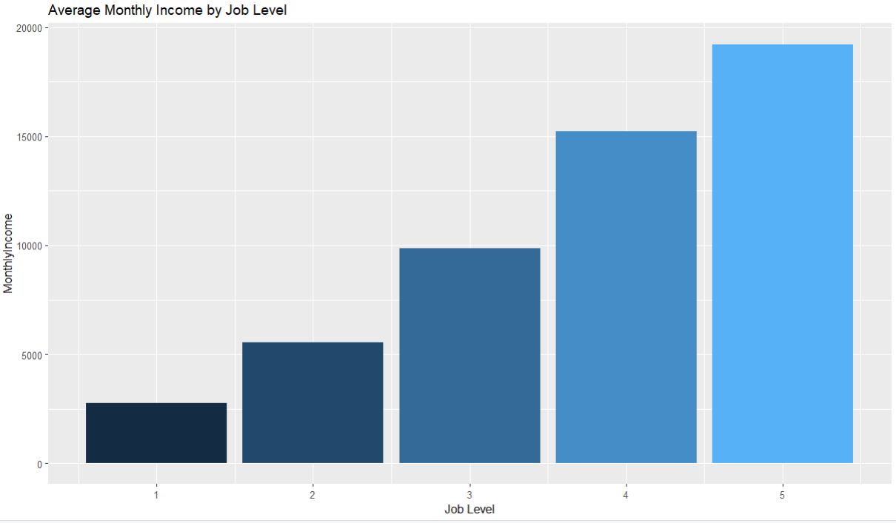
Relationship Between Monthly Income & Job Level

Slide 15
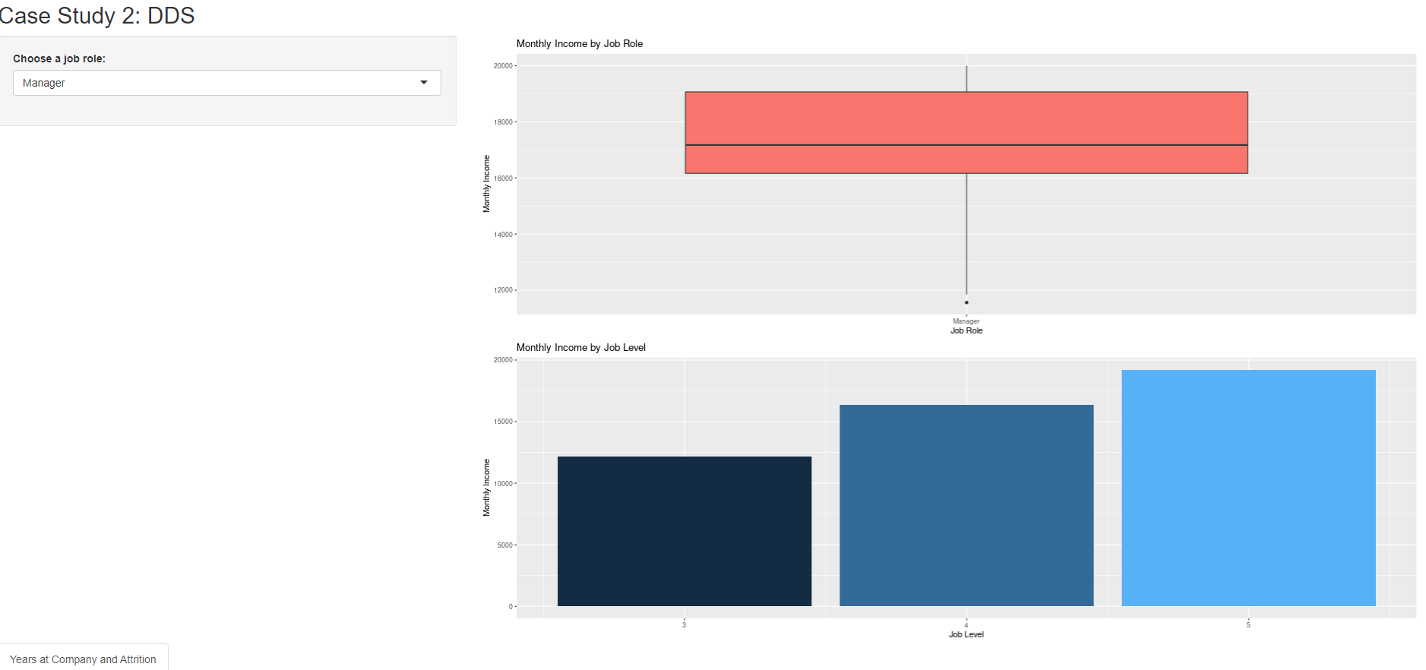
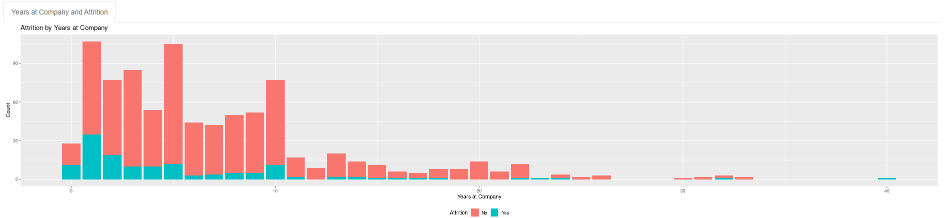
R Shiny App
Displays Boxplot for Monthly income by job role
Shows average monthly Income by job level

Slide 16
Thank you for your time !!
Email : Matthewgdavid210@gmail.com
Github: https://github.com/MatthewDavid210/CaseStudy2DDS
R Shiny App: https://matthewdavid210.shinyapps.io/CaseStudy2DDS/

